Slide 1

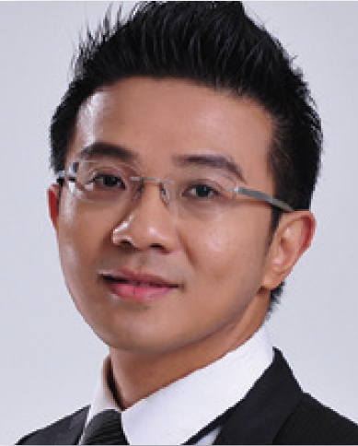

透過購物年金作物色、招募
Prospecting and Recruiting with Shopping Annuity
Johnny Huang
副總裁級
Field Vice President
本簡報中提到的收入等級純屬舉例說明，無意代表美安香港超連鎖™店主的一般收入，也無意表示任何超連鎖™店主皆可賺取同等收入。美安香港超連鎖™店主的成功與否，取決於其在發展事業時的努力、才能與投入程度。The income levels mentioned in the following presentation are for illustration purposes only. They are not intended to represent the income of a typical Market Hong Kong UnFranchise ™Owner, nor are they intended to represent that any given Independent UnFranchise ™ Owner will earn income in that amount. The success of any Market Hong Kong Independent UnFranchise ™ Owner will depend upon the amount of hard work, talent, and dedication which he or she devotes to building his or her Market Hong Kong Business.

Slide 2
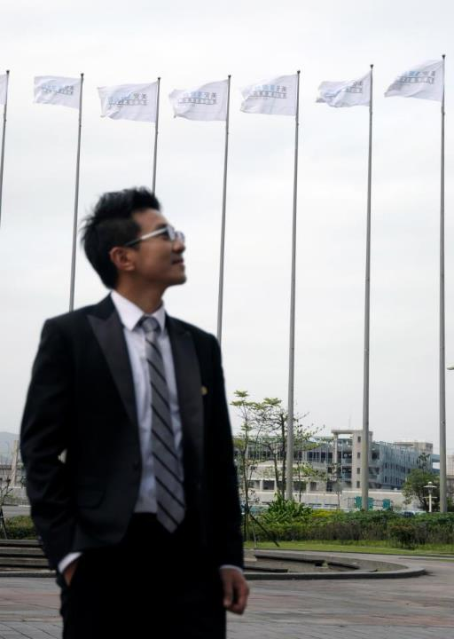
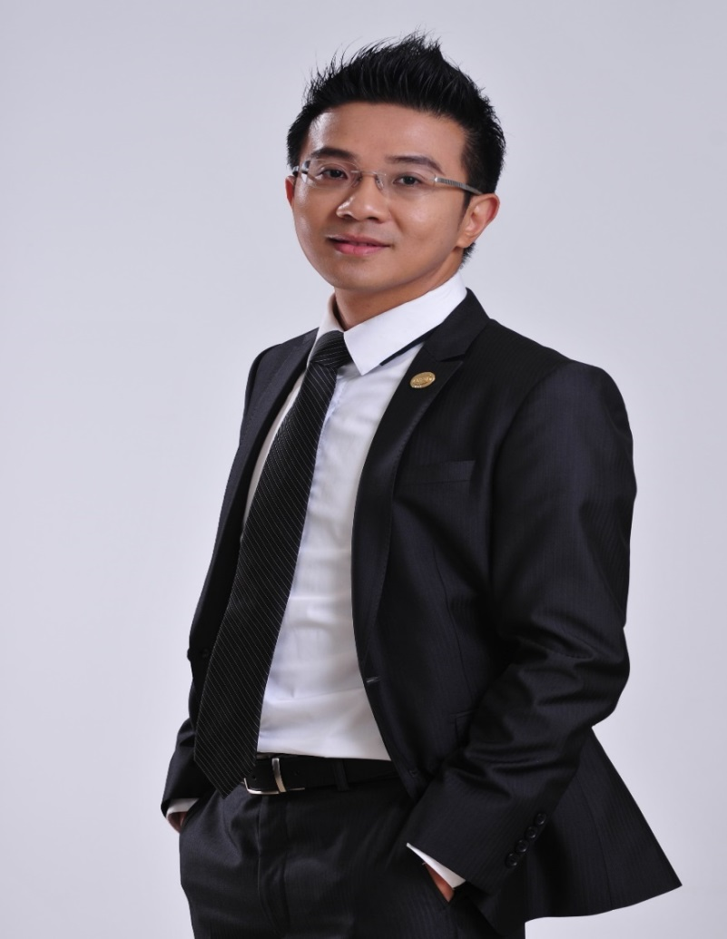

黃鵬升 Johnny Huang
Field Vice-President
27.6 million - 34.5 million / 4 weeks
Finance and Insurance Company 9 years
Ｐromoted to Manager at the age of 27
Former ~Local Coordinator of Taipei (South)
~Fund Management Committee
Current ~Member of Leadership Committee (TLC)
~Million Dollar Club Member
~International Advisory Council Member
2
Notes:
2

Slide 3

Recruiting with Shopping Annuity
黃鵬升 Johnny Huang

Slide 4
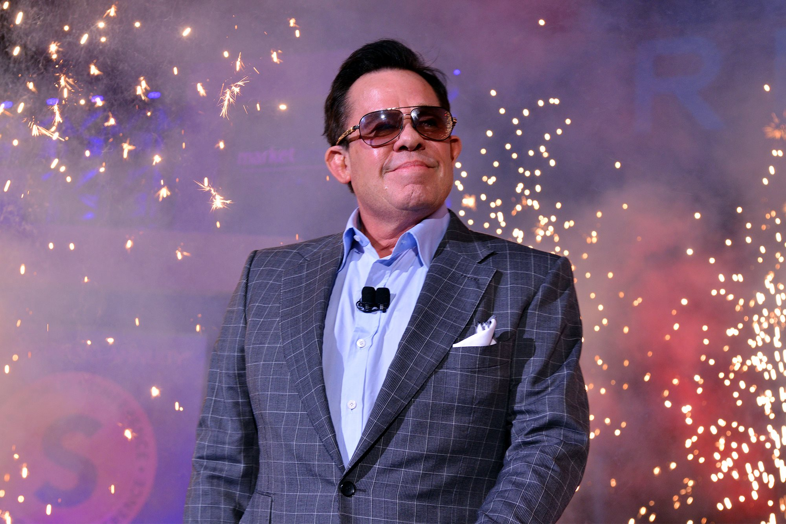
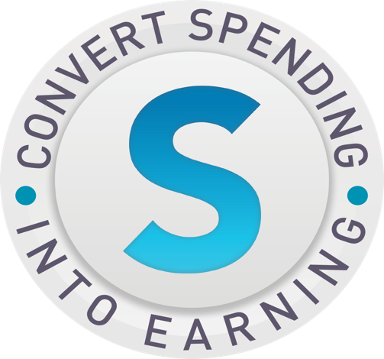
[
Will You Join me or not?
This is the original vision for Market America and Itis just beginning.
You can not stop an idea whose time has come!
It will work because we will make it work!
“We will change the way people shop and the economy by converting Spending into earning “ JR Ridinger
[

Slide 5
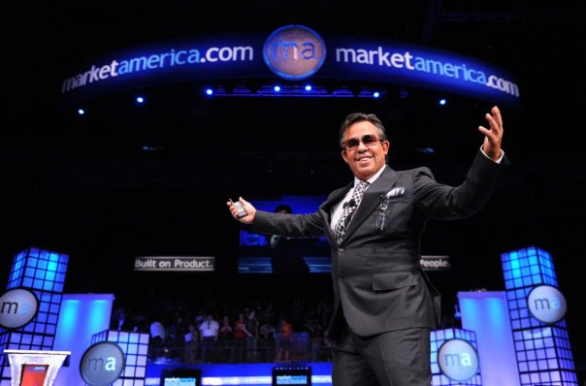
The ultimate goal of Market America:
1. US$100 million/day → US$10 billion/day
(Growth of 1000 times)
2. 25000 Directors
($138,000/4 weeks)

Slide 6
4-win Concept of SHOP.COM
Accelerate the formation of a new economy mode
Market America
Company
Partner
Stores
UFO
Preferred Customer

Slide 7

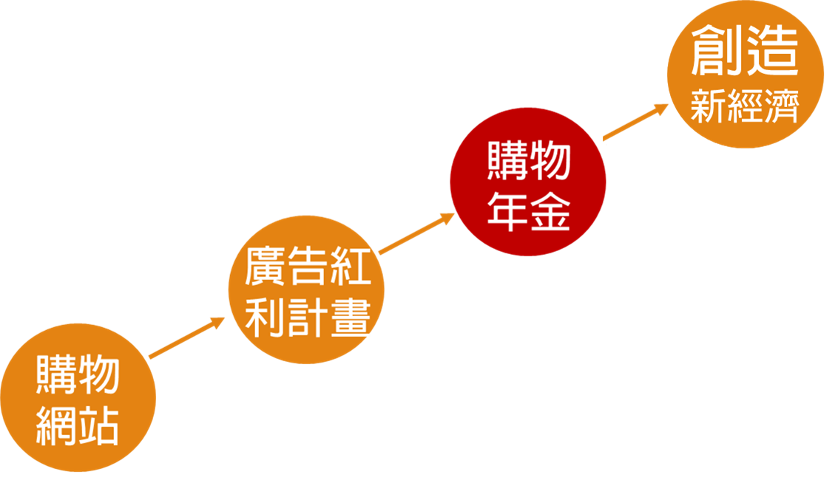
Create new economy mode
Shopping Annuity
Advertising Bonus program
Shopping Website

Slide 8
WHAT
IS
A
SHOPPING
ANNUITY?
THE SHOPPING ANNUITY IS A REVOLUTIONARY CONCEPT THAT HELPS SMART SHOPPERS CONVERT THEIR SPENDING INTO EARNING THROUGH SHOP•COM. UNLIKE A TYPICAL ANNUITY FROM A BANK OR INSURANCE CO., YOU DON'T HAVE TO INVEST A MASSIVE AMOUNT OF MONEY TO GET STARTED - YOUR INVESTMENT IS WHAT YOU ALREADY SPEND ON EVERYDAY PURCHASES. BY SHOPPING THROUGH SHOP•COM YOU CAN EARN UP TO 50% CASH BACK. CONVERT YOUR SPENDING INTO EARNING.
Notes:
Add:
The SA is based on threshold averages of spending based on statistics and verified through the Assesment. that is 500BV per month and $3000 Shop.com per month. The SA is not based on the SA Bonus program - the Bonus program is based on the SA threshold QUALIFICATIONS WHICH QUALIFY ONE to move from SA MEMBER TO SA MASTER MEMBER. The reason one does it in the savings and residual income derived from the MPCP or SA tracking. If there was no Bonus a person who has dome it is still saving and earning an annuity residual income that is significant and is not going to stop. I am trying to get people to understand that the SA Membership and master Membership is not the SABP which is a promotion, campaign or incentive. However , the SABP threshold criteria for qualifying for current Bonus (which will change every 6 months) is the same as Master Membership. the program is not the SABP, it is the SA membership and Master membership.

Slide 9
Start up your Shopping Annuity (2014Q4)
Definite periods!
Jan. 1 - Mar. 31 Apr. 1 - Jun. 30
Jul. 1 - Sep. 30 Oct. 1 - Dec. 31
Simple requirements!
Complete your Shopping Assessment
Complete the target of 1,500 BV for your own purchase of MHK products
Complete the target of shopping at local Partner Stores with $23,000
Shopping for at least HK$11,500 on your own

Slide 10


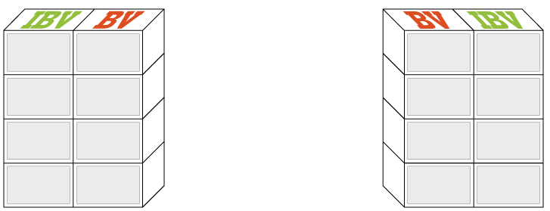
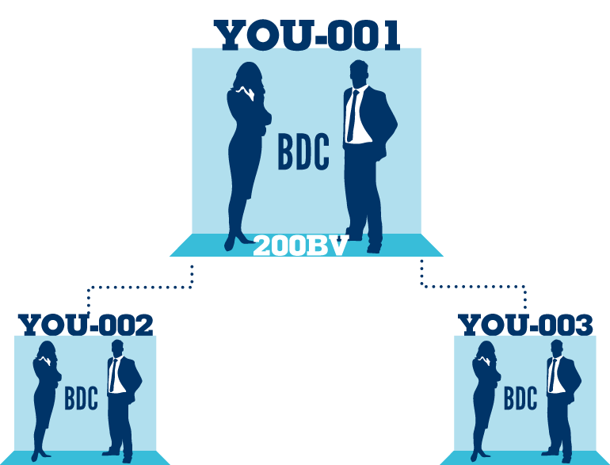
You Qualify for the SABP to:
Accrue and accumulate 100% of BV + IBV on every UFO qualifying for the SABP :
All the BV+ IBV already done.
FREE SHIPPING FOR 1 YEAR!
The 1500 qualifying BV and IBV (~300 IBV) on $3000 at SHOP.COM on yourself and every UFO in your group that does the same.
The Bonus BV (200-400BV)
  20% ADDITIONAL BV BONUS ON ALL BV ORDERS for Quarter (+300) ON YOU + everyone who qualifies on organization!
  + IBV (100- 150 IBV)
The Duplication bonus of 50BV/25 IBV on everyone you get to do it
With 10 qualified per leg – eligible for
$600 /wk. IBV LB
Hint: anyone already earning a BV leadership bonus weekly should be able to earn a IBV Leadership bonus from the Shopping annuity.36.
Notes:
TRAINERS NOTES:
This is an organization of 50 people on the left and 50 people on the right
Everyone is doing the minimum activity requirements / not participating in the Shopping Annuity
The multiplier is small because noone is really doing the business and definitely not doing the shopping annuity , therefore only creating $600 per month in BV checks and $300 every 3 months in IBV commissions.

Slide 11

Income and Family Statistics
According to 2009/10 Household Expenditure Survey and the Rebasing of the Consumer Price Indices released by the Census and Statistics Department (http://www.statistics.gov.hk/pub/B10600082010XXXXB0100.pdf)
Common Consumer
income and spending
HK$586,491
HK$565,693
HK$259,476
Total pre-tax income
Total after-tax income
Average annual consumption

Slide 12
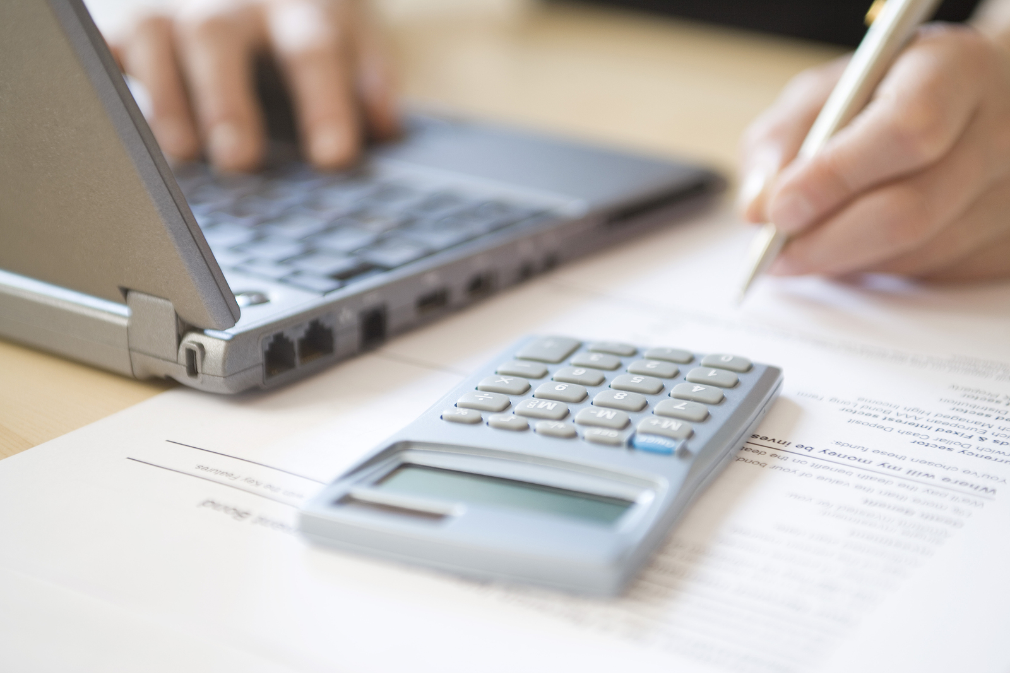
You are already consuming...
Why not converting your spending into earning?

Slide 13
What is the difference between your monthly consumption and the average monthly consumption?
Food
Household
Clothing
Total annual consumption
HK$175,044
Transportation
Health Care
Entertainment
Average monthly consumption
Visit ShoppingAnnuity.com to complete your
Shopping Annuity Assessment
Personal care and services
Books and Stationery
HK$14,587
Miscellaneous expenses

Slide 14
You make the choice!
You can continue your consumption,
helping others earning money
Or
You can join our SA
to convert spending into earning, earn for yourself!
Which one would you choose?
Notes:
TRAINERS NOTES:
This is critical! Do not skip through this slide. It’s the equivalent of the the slide in the UBP which asks if they want the 45 year plan or the UnFranchise.
You can continue to spend money you are already spending the way that you’re spending it. This will continue to make money for the companies you purchase from and earn you nothing. Nothing changes! OR
You can convert your spending into earning. Continue to purchase all of the things you are going to purchase anyway and be paid on those margins from your spending as well as the spending of anyone you lead to directly or indirectly.

Slide 15
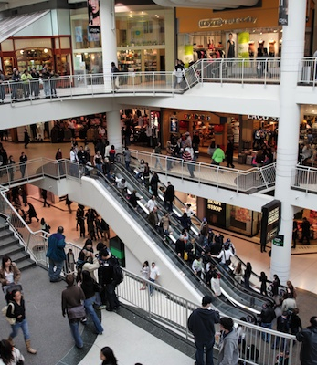

Traditional
walk-in stores
online stores
convert to
Notes:
TRAINERS NOTES:
You have to be aware of the money you would “leak” in the stores and switch it to SHOP.COM
If you are already an online shopper, you have to shift your spending behaviors to go through SHOP.COM first or simply install and login to ShopBuddy to make sure you are funding your Shopping Annuity.

Slide 16
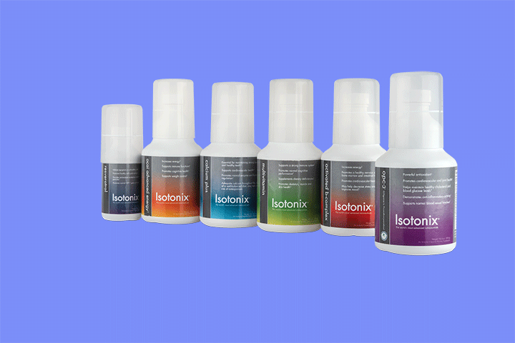

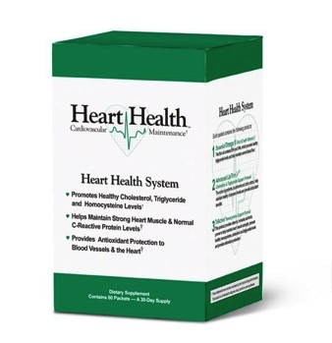
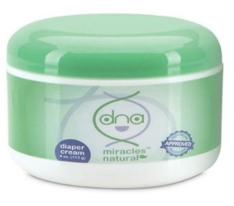
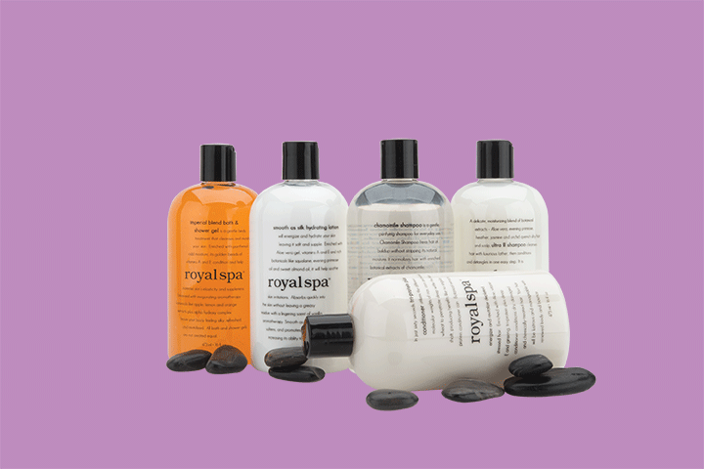

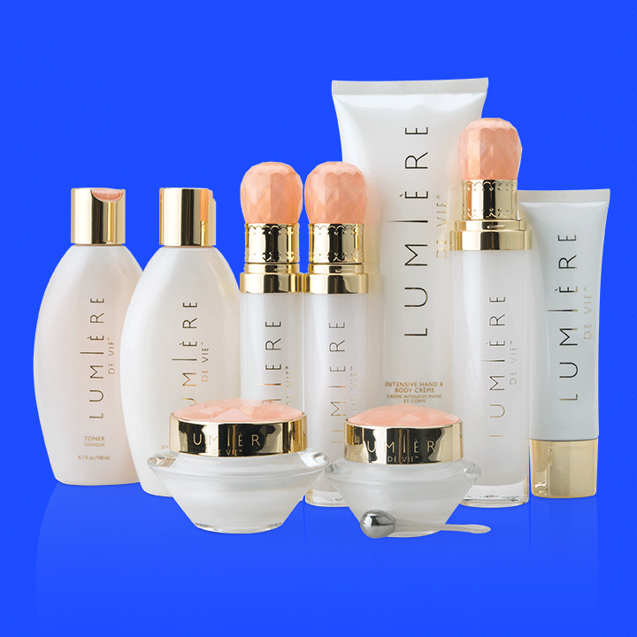
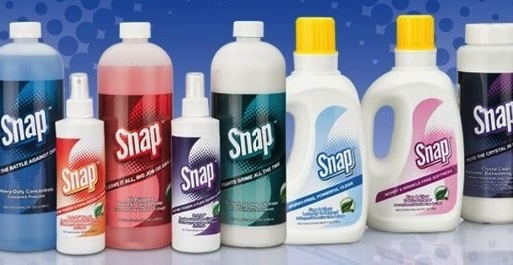
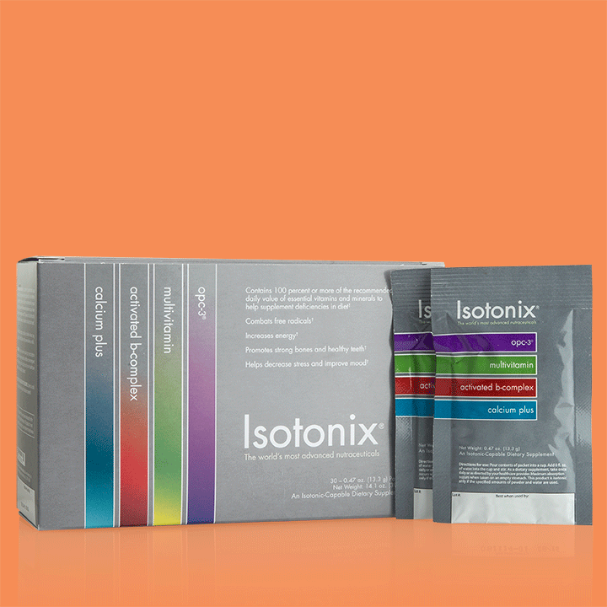

Exclusive agent brand
better quality
better price
Cashback
From now on, you can search the products you want in SHOP.COM
and stop purchasing from other brand. This help you to apply SA.
Notes:
TRAINERS NOTES:
Best of all, we aren’t asking you to sacrifice quality or price. Our exclusive brands are superior products, with better prices than the competition and we pay you Cashback for purchasing them.
Not to mention, by choosing these superior products, you are funding your Shopping Annuity

Slide 17


Selling in one minute?
Can you provide
the valuable information
to people around you?

Slide 18


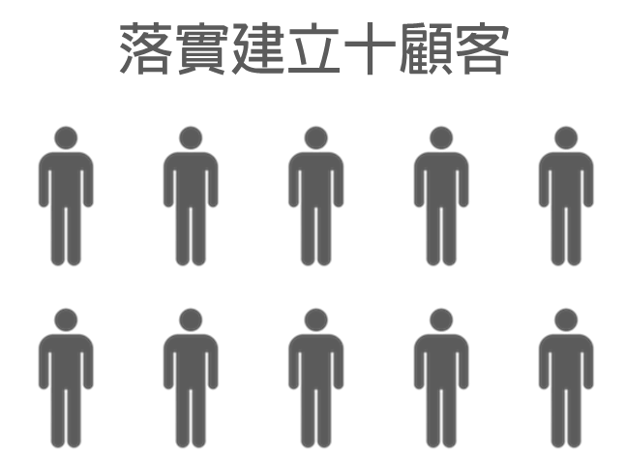
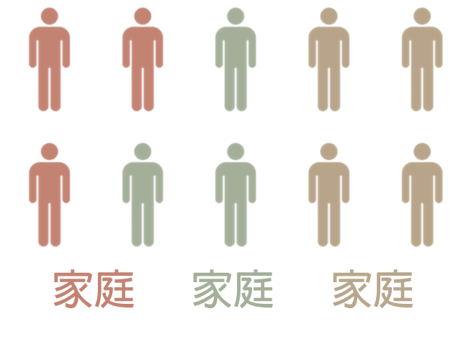



How to achieve the target of 1500BV?
Favorite product
UFO
Register Base 10
Share with others
Care about them
Family Family Family
Monthly : 125 BV X 4 Family = 500 BV

Slide 19
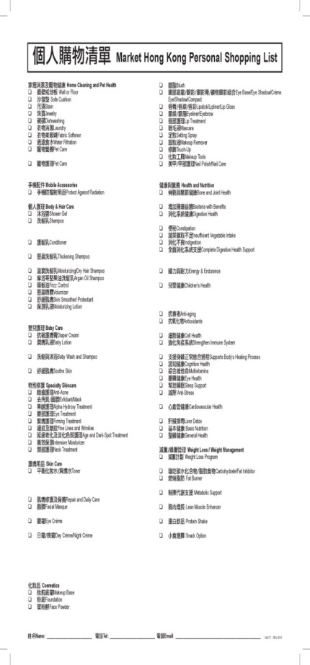
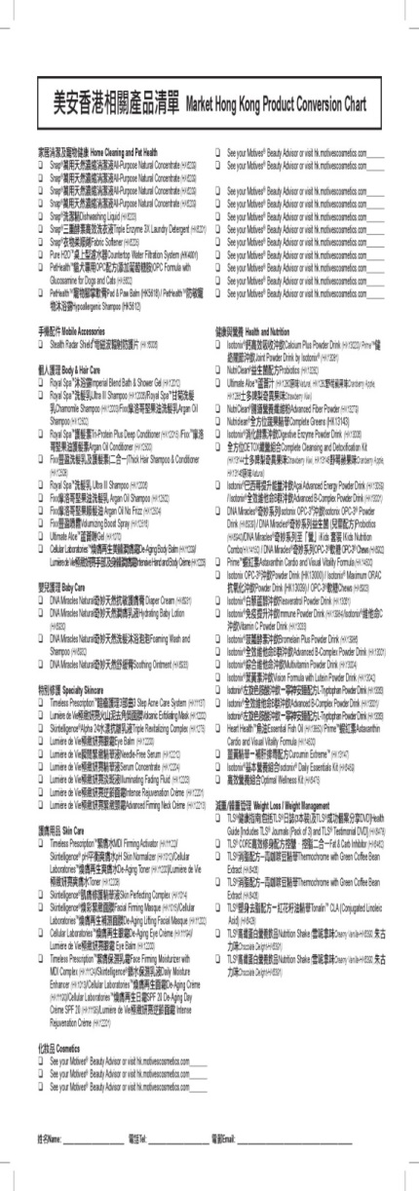
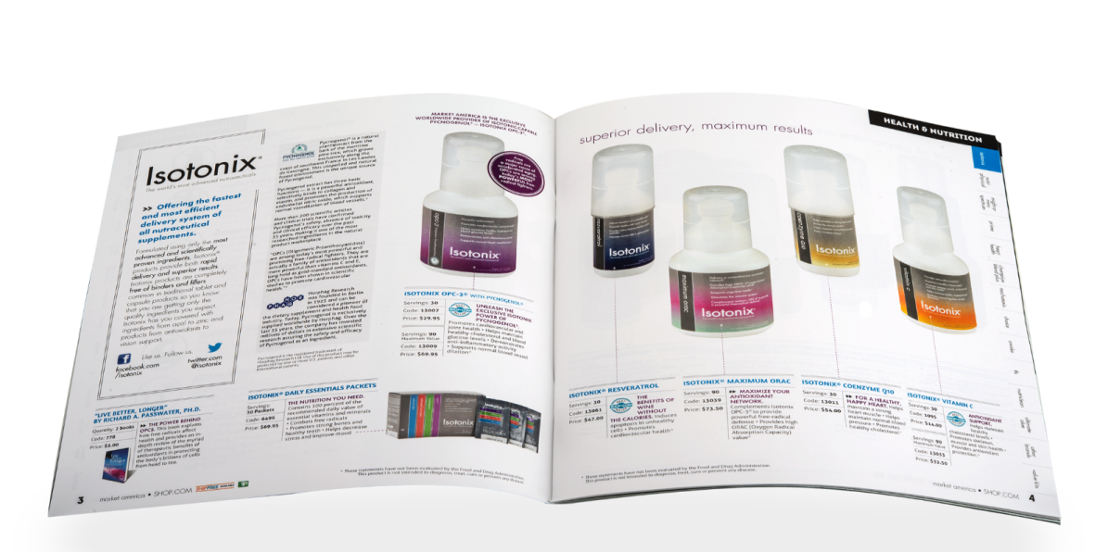
Hong Kong ma Catalog
MHK Product Catalog

Slide 20
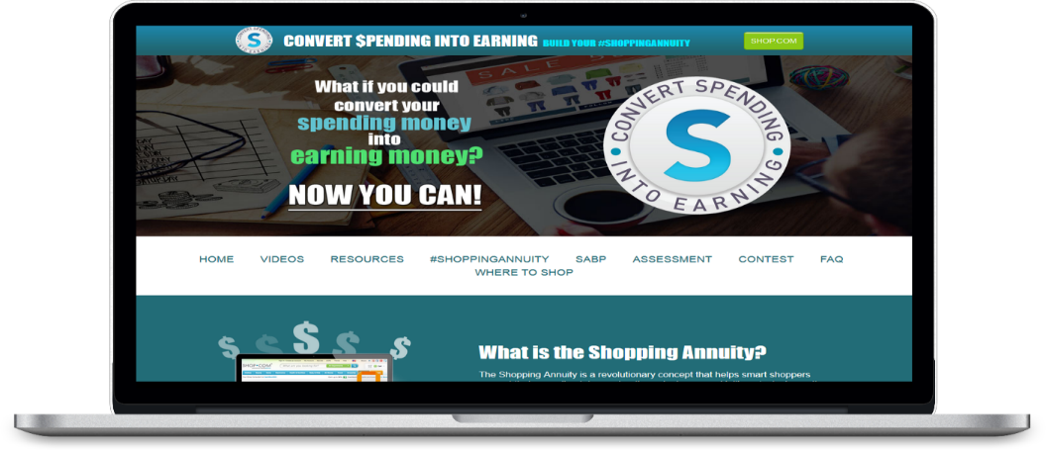
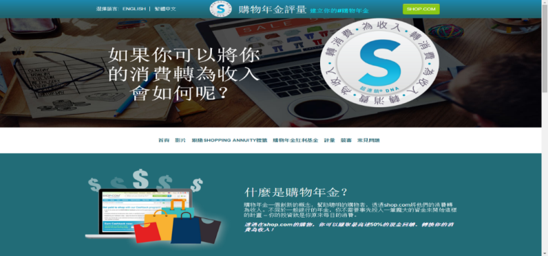
Complete
SA Assessment
SA Assessment helps you
    to find out those household products that can be replaced by exclusive brand product of SHOP.COM
    Calculate the estimated BV and cashback
Download from
www.shoppingannuity.com

Slide 21
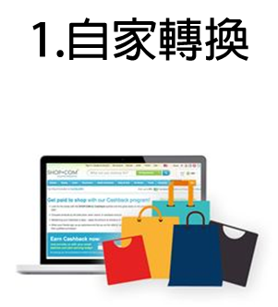





HK$ 23,000 The key is the way you do!
5. Follow up
1. Transfer by yourself
2. Help others to buy
3. Show them the website
4. Register as customer
One-to-one, Sustainable Customers

Slide 22

Create your SA
Economic Synergy
Create your own
“Fixed Consumption”
to earn a sustainable income
Save
money
Earn
income
Invite your partners and preferred customers to join, accelerate the growth of sustainable income

Slide 23
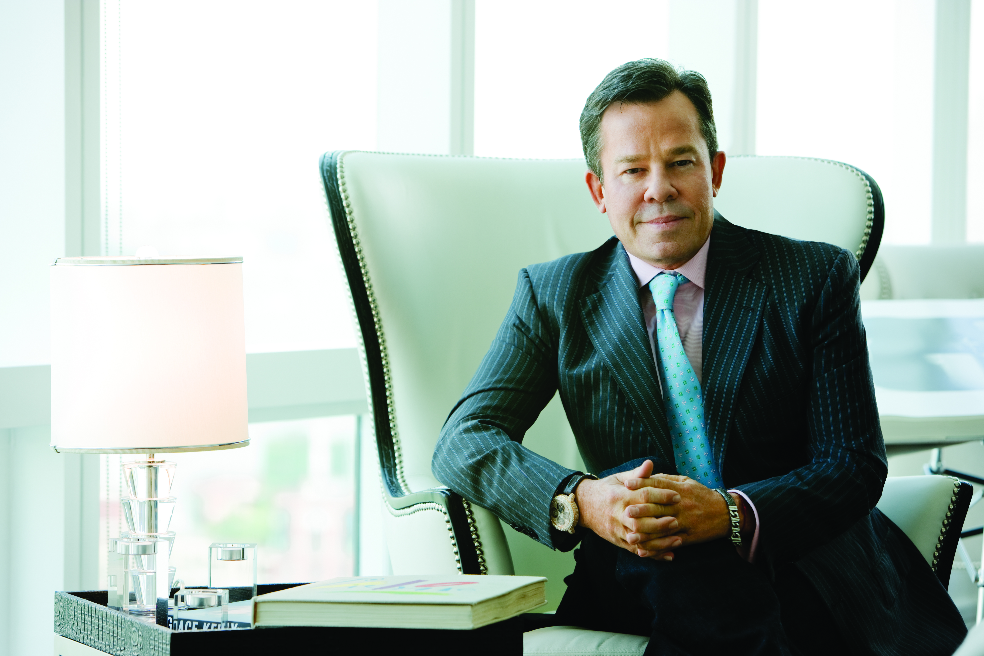
Practice what you preach.
You have to succeed so that others can make their dream comes true.
JR Ridinger

Slide 24

Economic benefit
by applying SA

Slide 25
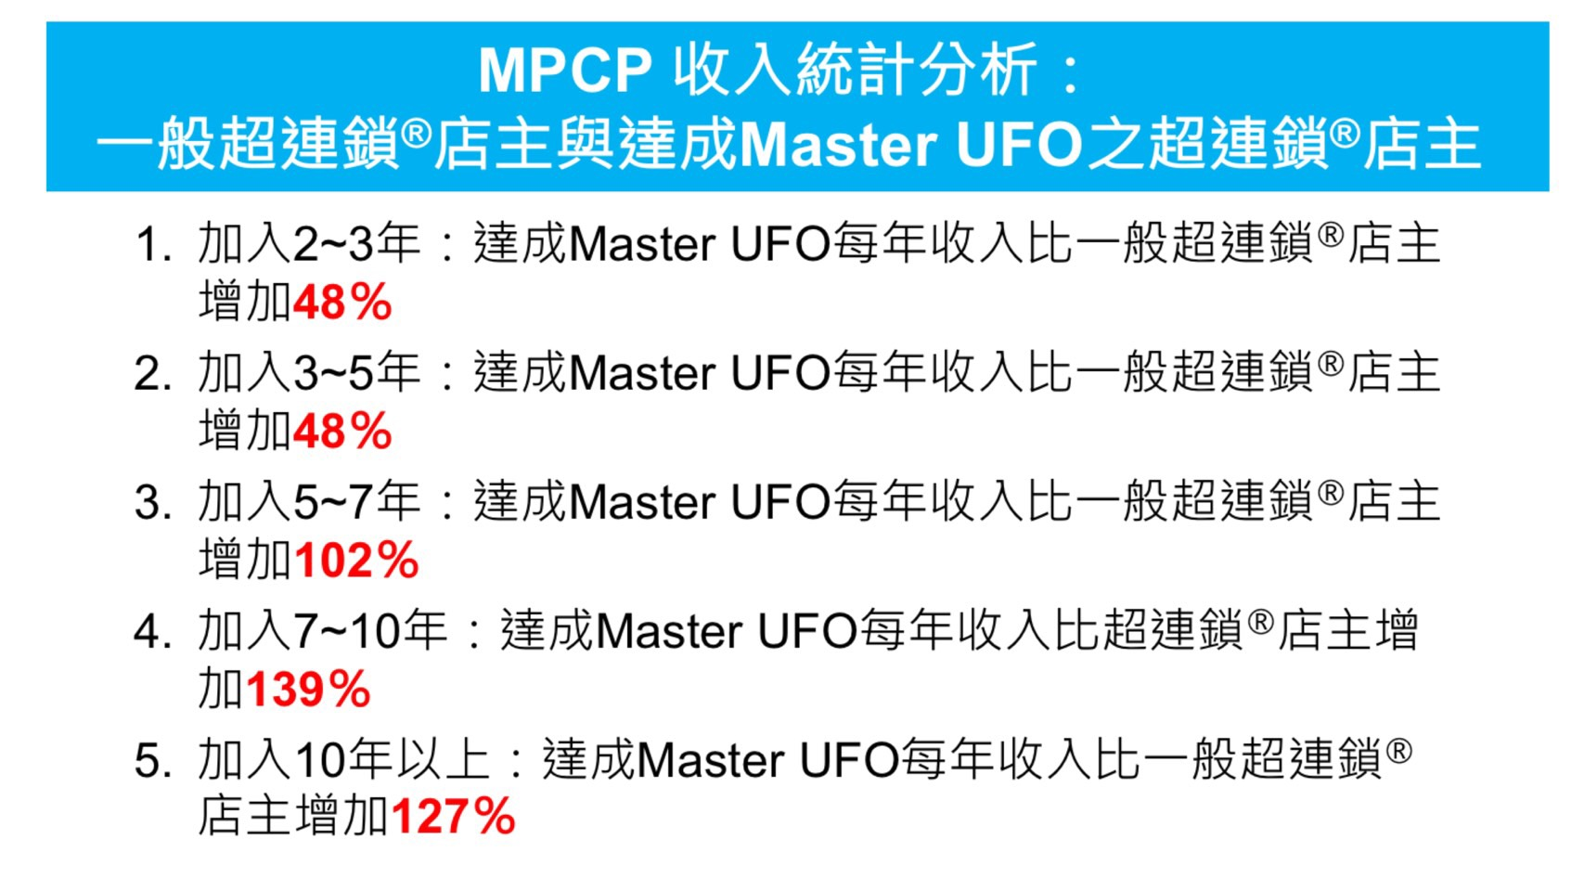

MPCP Total Income Analysis
Differences between UFO and Master UFO
2-3 years : Annual income increase rate of Master UFO 48% higher than UFO
3-5 years : Annual income increase rate of Master UFO 48% higher than UFO
5-7 years : Annual income increase rate of Master UFO 102% higher than UFO
7-10 years : Annual income increase rate of Master UFO 139% higher than UFO
Over 10 years : Annual income increase rate of Master UFO 127% higher than UFO

Slide 26
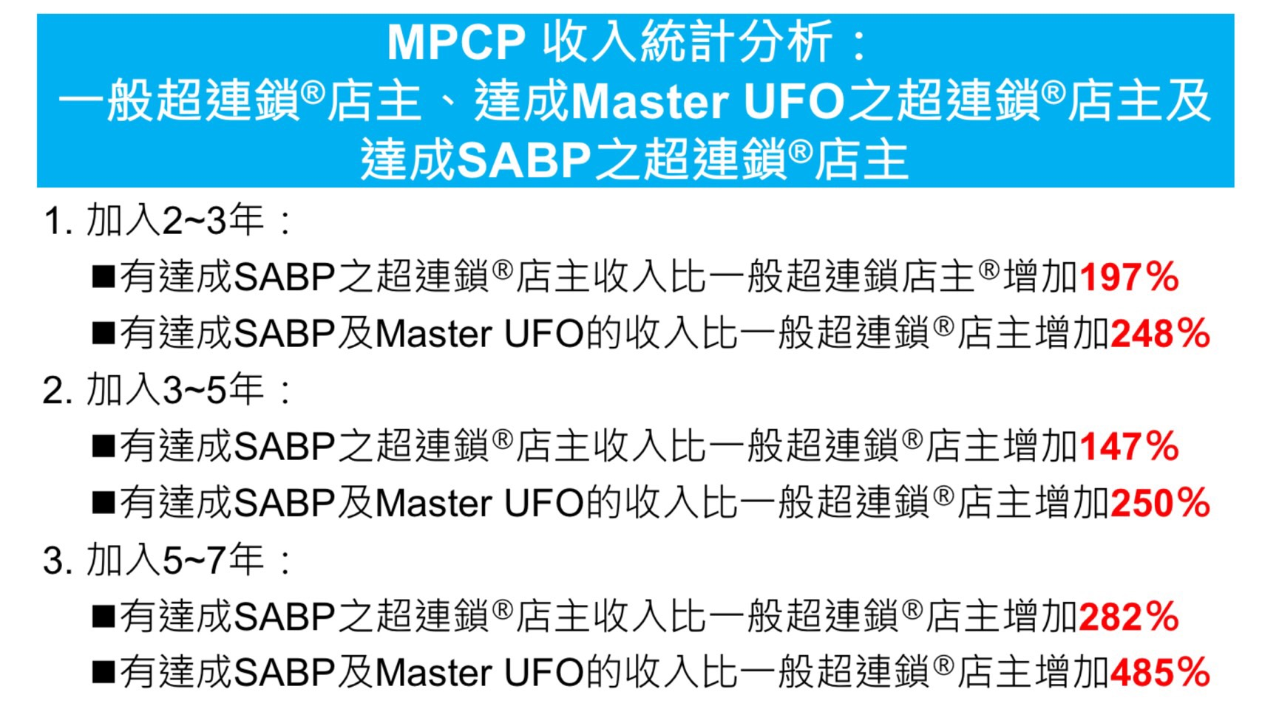
MPCP Total Income Analysis
UFO Master UFO SABP UFO
2-3 years :
Increase rate of SABP UFO 197% higher than UFO
Increase rate of SABP and Master UFO 248% higher than UFO
2. 3-5 years :
Increase rate of SABP UFO 147% higher than UFO
Increase rate of SABP and Master UFO 250% higher than UFO
3. 5-7 years :
Increase rate of SABP UFO 282% higher than UFO
Increase rate of SABP and Master UFO 485% higher than UFO

Slide 27
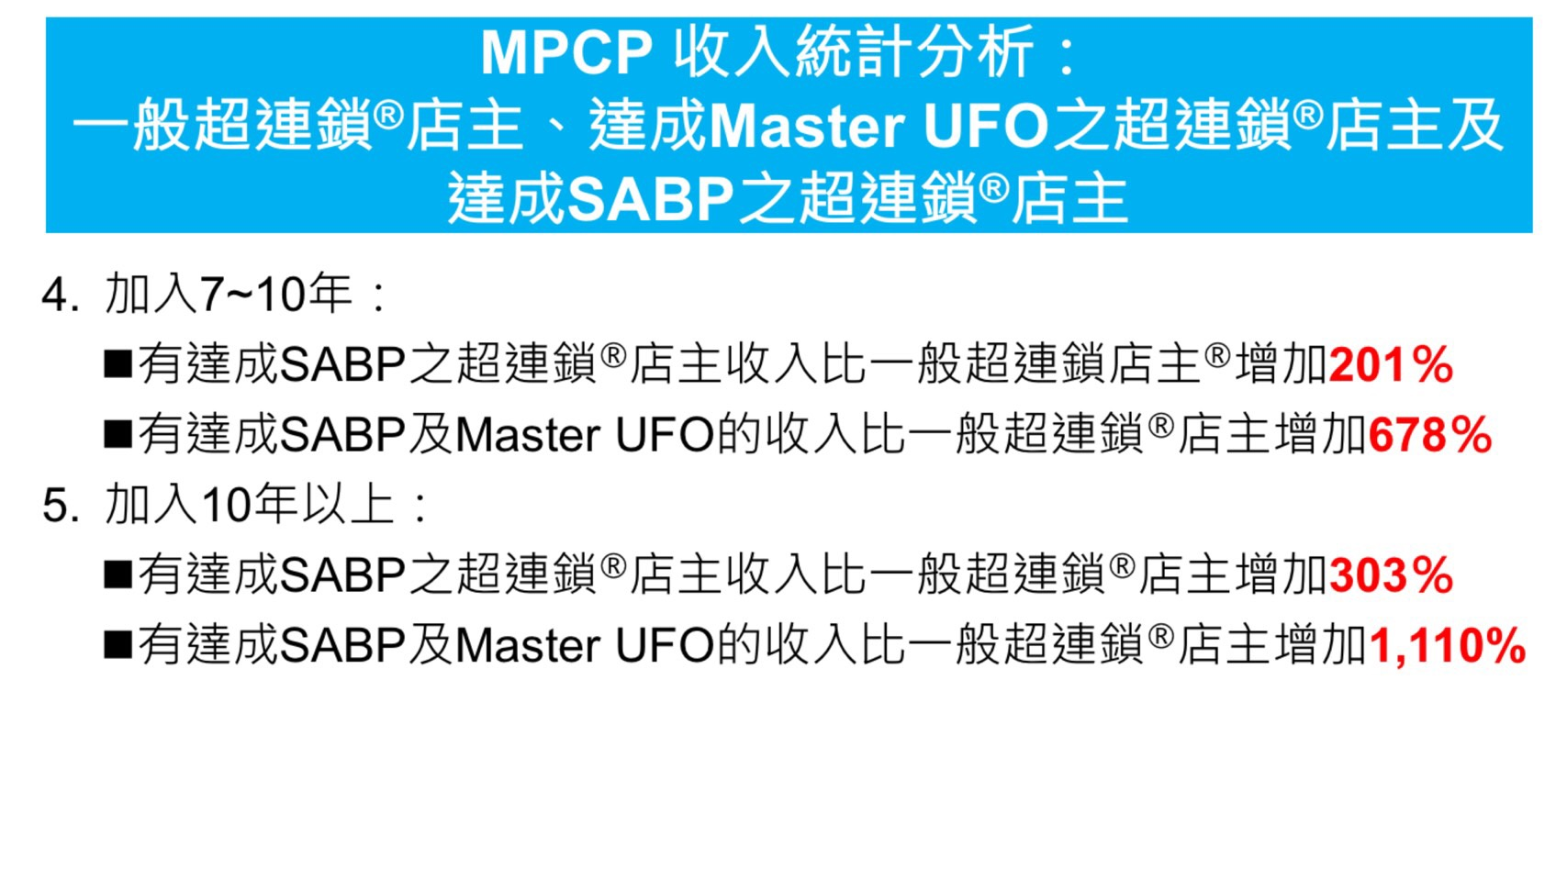
MPCP Total Income Analysis
UFO Master UFO SABP UFO
4. 7-10 years :
Increase rate of SABP UFO 201% higher than UFO
Increase rate of SABP and Master UFO 678% higher than UFO
5. Over 10 years :
Increase rate of SABP UFO 303% higher than UFO
Increase rate of SABP and Master UFO 1,110% higher than UFO

Slide 28

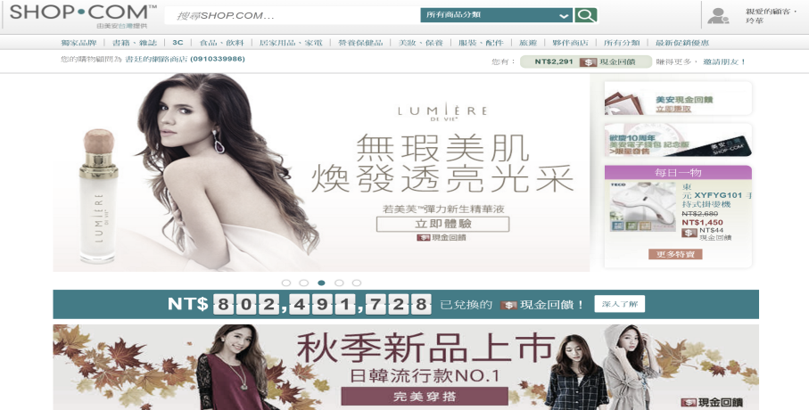
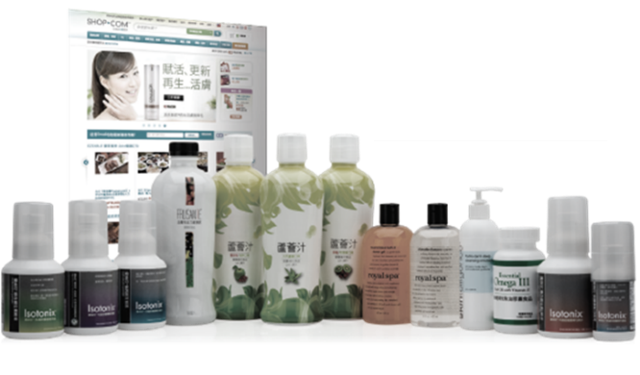
The Key: How we lead our partners in the begining
To build up
loyal customers
Invite them to UBP
【 Perfect copy】 Partners build up their basic skills during selling, and copy those skills to new partners.
【 Revenue increase 】The Average output value of you team increased with both the retail profits and income.
【 Confidence build up】 The experience in communicating with customers builds up your confidence in making new friends.

Slide 29
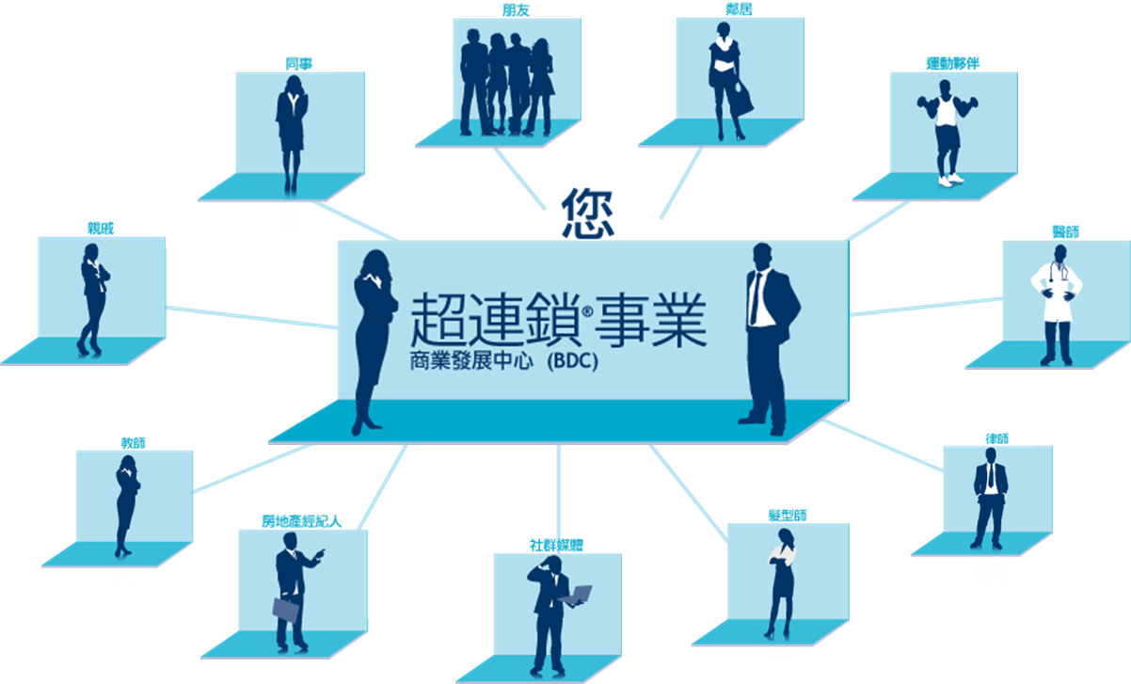
MA Business-Building Strategy
You
A month before joining us, focus on building up the relationship with 30 preferred customers.
Strengthen your basic skills during the process.
After that, start recruitment, to greatly improve the combat effectiveness of your team.

Slide 30


Register as a preferred customers
Arrange to follow the pan
  Visit the site HK.SHOP.COM
    Set HK.SHOP.COM as your front page
    Download HK.SHOP.COM to your phone
    Join your shopping Service chatroom
    Fill in the Home Assessment

Slide 31

Retailing target
The monthly target of new UFO is to purchase and use products and obtain 200 BV and 20 IBV
To register a minimum of 10 preferred customers, and encourage each of them to purchase products and obtain at least 30 BV / 20 IBV every month.
to produce 300 BV and 200 IBV
PC -
PC -
PC -
PC -
PC -
PC -
PC -
PC -
PC -
PC -
  Preferred customers = 30 BV and 20 IBV
  UFO purchases 500 BV and 220 IBV every month.

Slide 32
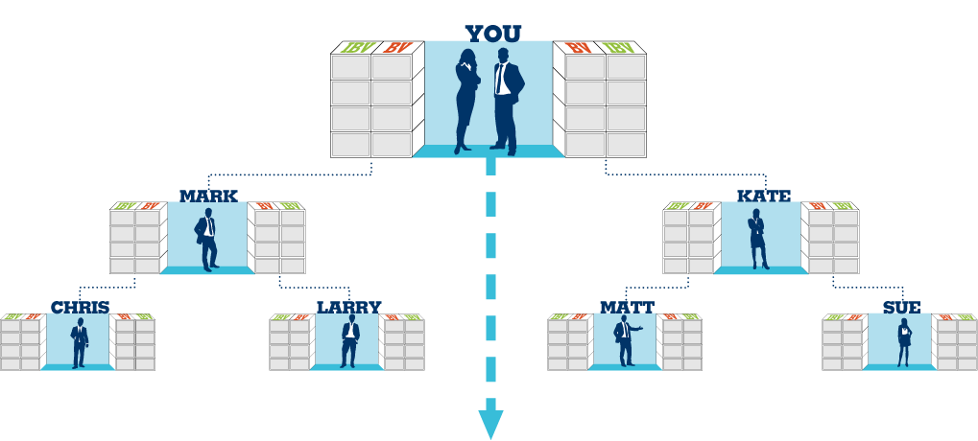

Business goal - Base 10, seven strong
7 UFO, 10 preferred customers for each
Each of UFO can purchase 500 BV and 200IBV every month
(Personal puchase and Preferred Customers purchase)
Commission = Earn $2300 from BV every month and earn $2300 from IBV every two months
1500 BV & 600 IBV
1500 BV & 600 IBV
5 PC
5 PC
500 BV & 200 IBV Points can be held
5 PC
5 PC
5 PC
5 PC
500 BV & 200 IBV
5 Preferred Customers
5 PC
5 PC
5 PC
5 PC
5 PC
5 PC
5 PC
5 PC
500 BV & 200 IBV
500 BV & 200 IBV
500 BV & 200 IBV
500 BV & 200 IBV
The above slide shows the Accumulate and Accrue of BV and IBV

Slide 33

The Culture of Wolf Instinct

Slide 34

Basic business requirement
  Every UFO produces 50 BV and 10 IBV per month
The power of action
Monthly target and Base 10
  Every UFO produces 200 BV and 20 IBV per month
  Preferred customers of every UFO produce 200 BV and 20 IBV per month
Shopping Annuity and Base 10
  Every UFO produce 500 BV and 200 IBV per month
  Preferred customers of every UFO produce 300 BV and 200 IBV per month

Slide 35

Organization reaching the basic business requirement
Commission = $4,600/month (BV) and $2,300/3 months (IBV)
Basic Business Requirement
Every UFO purchases50 BV and 10 IBV every month
Total = Every UFO 50 BV + 10 IBV
You can earn $2300 - $4600 through BV every two cycles and $2300 though IBV every three months
50 UFO’s x 50 BV = 2,500 BV/Month
Plus
50 UFO’s x 10 IBV = 500 IBV/Month
50 UFO’s x 50 BV = 2,500 BV/Month
Plus
50 UFO’s x 10 IBV
= 500 IBV/Month
This slide shows the Accumulate and Accrue of BV and IBV

Slide 36
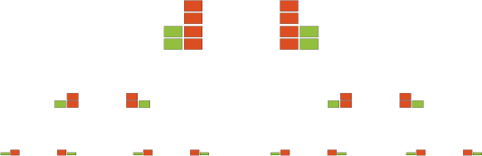
Organization reach the monthly target and Base 10
Commission = $46,000/month (BV) and $23,000/months (IBV)
Monthly target for every UFO is 200 BV and 20 IBV
Base 10 : Every UFO registers 10 preferred customers
300 BV + 200 IBV
Total = Every UFO 500 BV + 220 IBV
You can earn $11,500 through BV every cycle and 11,500 though IBV every two cycles
50 UFO’s x 500 BV = Monthly25,000 BV
Plus
50 UFO’s x 200 IBV = Monthly10,000 IBV
50 UFO’s x 500 BV = Monthly25,000 BV
Plus
50 UFO’s x 200 IBV = Monthly10,000 IBV
This slide shows the Accumulate and Accrue of BV and IBV

Slide 37
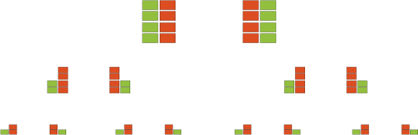
Organization reach the monthly target and Base 10
Commission = $64,400/month (BV) and $46,000/months (IBV)
Shopping Annuity Every UFO is 200 BV and 20 IBV every month
Base 10 Every UFO registers 10 preferred customers
300 BV + 200 IBV
Total = Every UFO 800 BV + 400 IBV
You can earn $16,100 through BV every cycle and 11,500 though IBV every cycle
50 UFO’s x 800 BV = Monthly40,000 BV
Plus
50 UFO’s x 400 IBV = Monthly20,000 IBV
50 UFO’s x 800 BV = Monthly40,000 BV
Plus
50 UFO’s x 400 IBV = Monthly20,000 IBV
This slide shows the Accumulate and Accrue of BV and IBV

Slide 38
Basic business requirement
  Average monthly commission $5400
The power of action
Monthly target and Base 10
  Average monthly commission $69,000
SA and Base 10
  Average monthly commission $110,400

Slide 39

EXAMPLE: Qualify to Accumulate and Accrue
BV and IBV on the Shopping Annuity with YOU + 10L/R)!
Accumulation or Accrual of BV
In MPCP with SA + SABP
Accumulation or Accrual of IBV
In MPCP with SA + SABP
500 BV/ month = 1500 BV/qtr.
SABP Bonus BV = 400 BV/qtr.
Subtotal = 1,900 BV/qtr.
10 x 1850 = 19,000 BV/ qtr.
10 UFO’s left x 50BV= 500 BV/ qtr.
10UFO’s right x50BV = 500 BV/ qtr.
TOTAL…………………………20,000 BV/qtr.
ANNUAL……………………..80,000 BV/yr.
Plus You = 7600BV = 87,600BV/yr.
VS. BEFORE. BEFORE.
Annual: 4qtrs. X 12,000 BV/yr.
7.3 times more BV
on same size group!
$1000/mo. Partners = $3000/qt. $150 to 450 IBV
Say 10% = 300 IBV/qtr.
SABP IBV Bonus = 140 IBV/qtr.
Subtotal = 440 IBV/qtr.
10 X 440 = 440 IBV/qtr.
10 +10 UFO’S on left x 25 IBV = 250 IBV/qtr.
TOTAL................................. 4900 IBV/qtr.
ANNUAL ………………………… 19,600 IBV/yr.
Plus You =1760/yr. ………… 21,360 IBV/yr.
VS. BEFORE: 9 IBV/mo. x 3mo =24 IBV/qtr. x 20 = 480 IBV/qtr.
Annual : 4qts. X 480 IBV = 1920 IBV/yr.
11.1 times more IBV on the same group

Slide 40
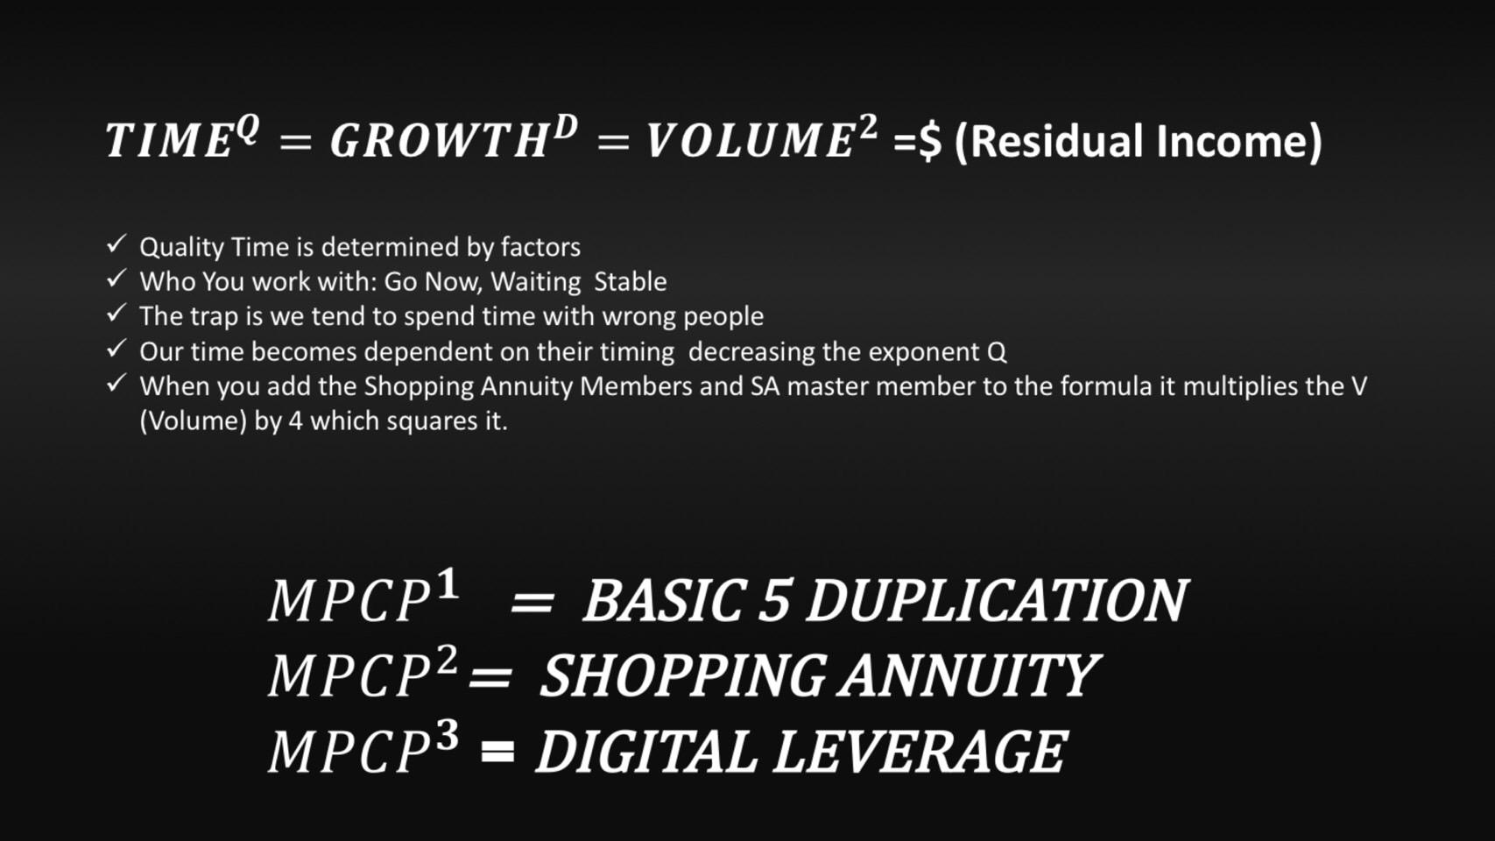
Formular of success
T^{Q} = G^{D} = BV / IBV = $
effectiveperiod = Duplicatable System = Performance = income

Slide 41
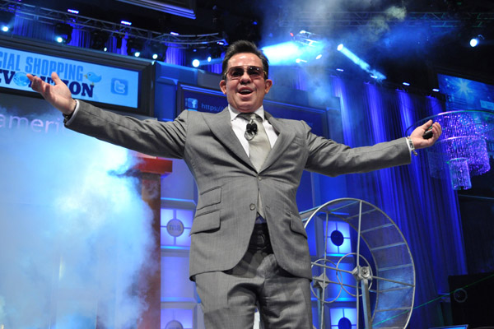
Entrepreneur
= Dreamer
Dream Big
Because you'll never be bigger than your dreams

Slide 42
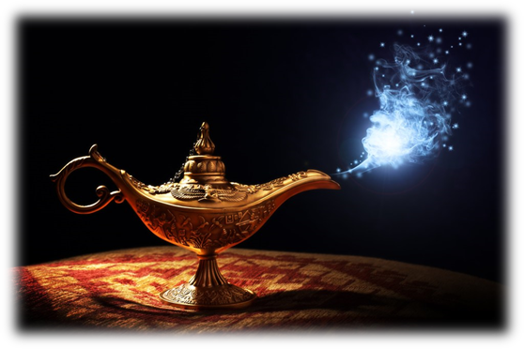
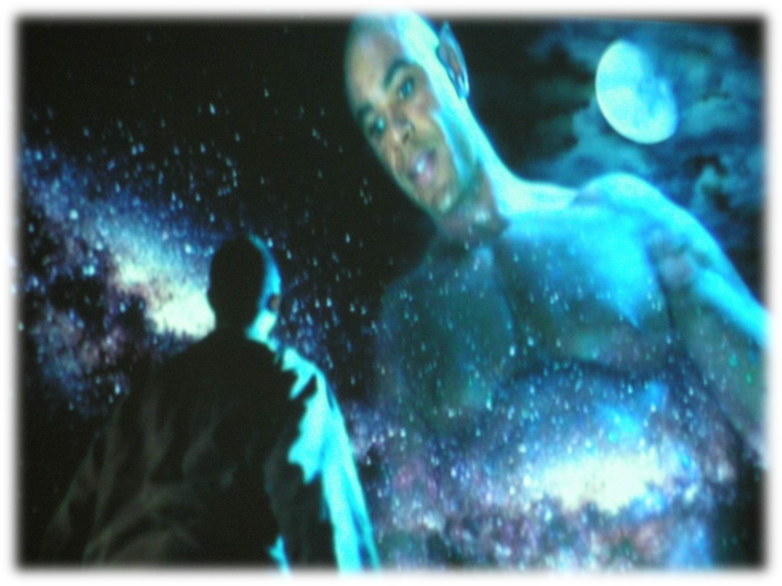
When you run your shop.com business...
Have you ever made a wish?
Building up a business Earning $16,100 for weekly sustainable income

Slide 43
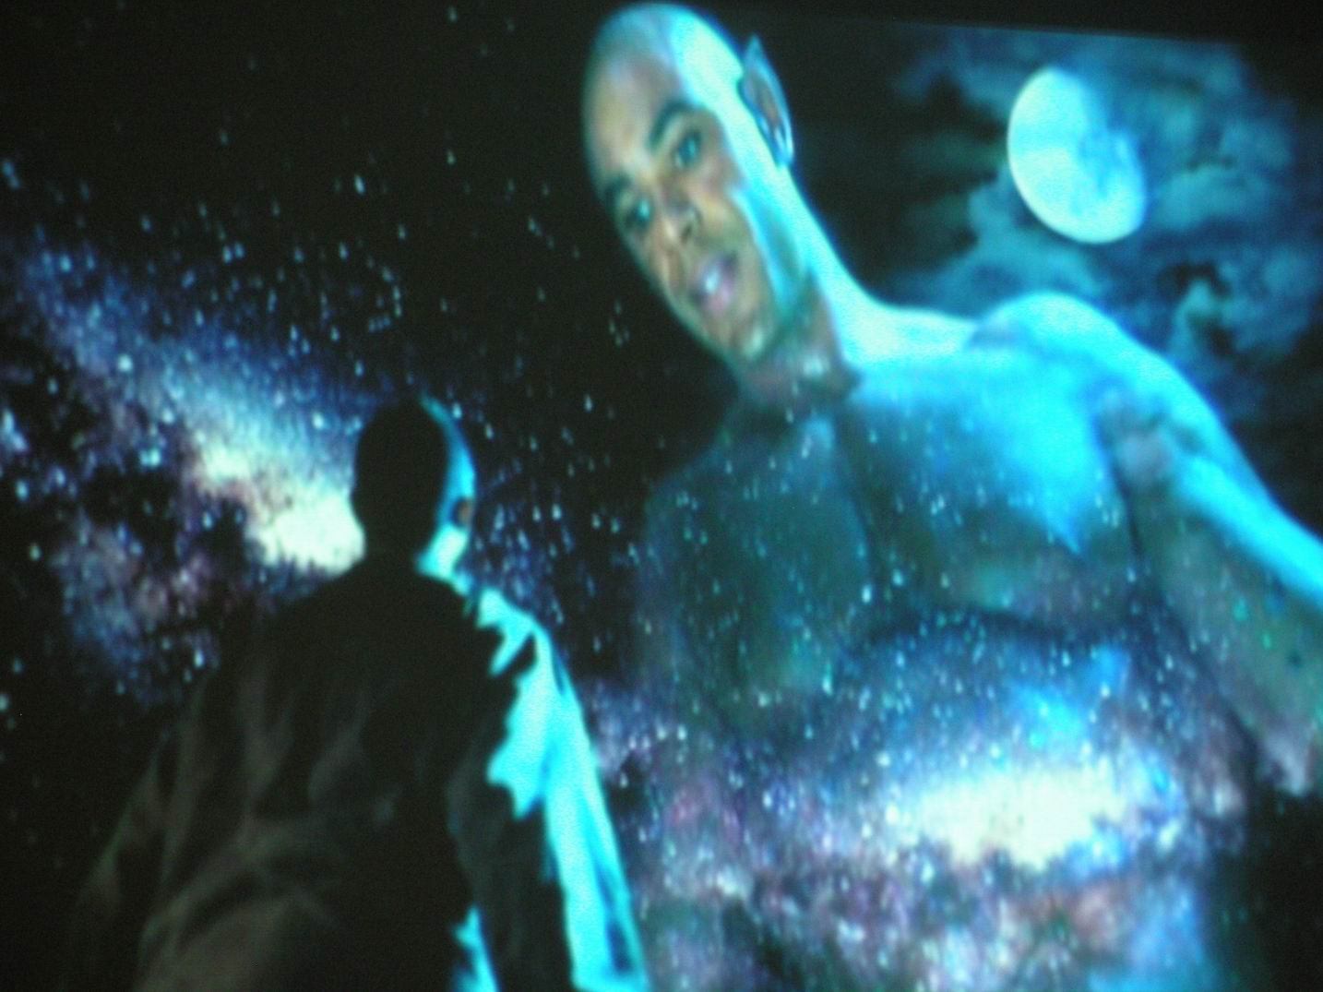

Aladdin's Magic Lamp will say
Develop you own Shopping Annuity
And lead your partners
to complete the Shopping Annuity!

